Slide 1
Philippine disasters and
Project NOAH
Alfredo Mahar Francisco A. Lagmay

Slide 2

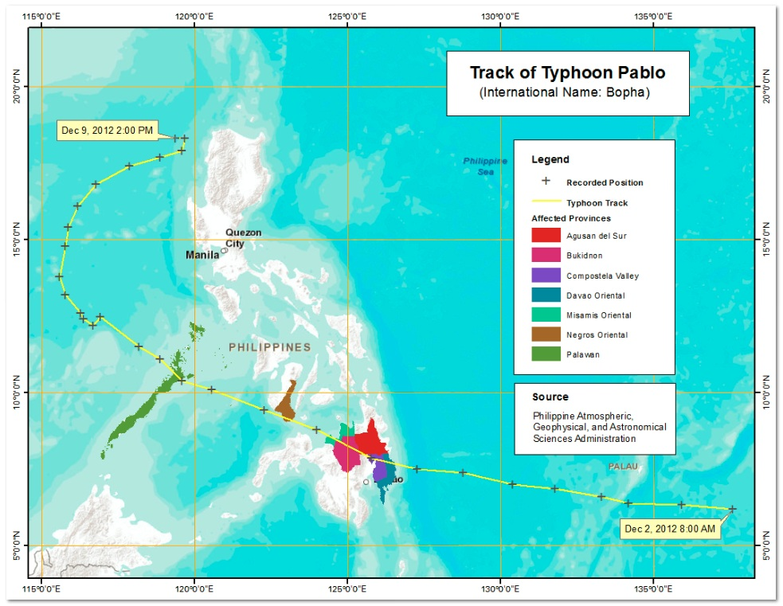
Lagmay et al., 2013

Slide 3
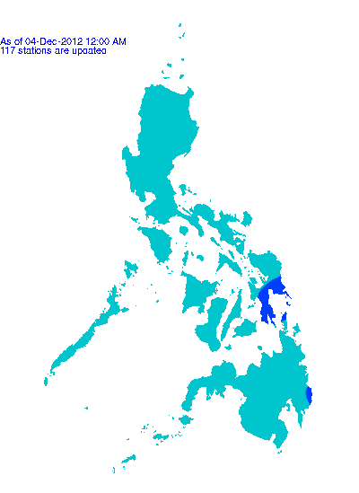
Lagmay et al., 2013
Rainfall contour map
On 4 December 2012

Slide 4
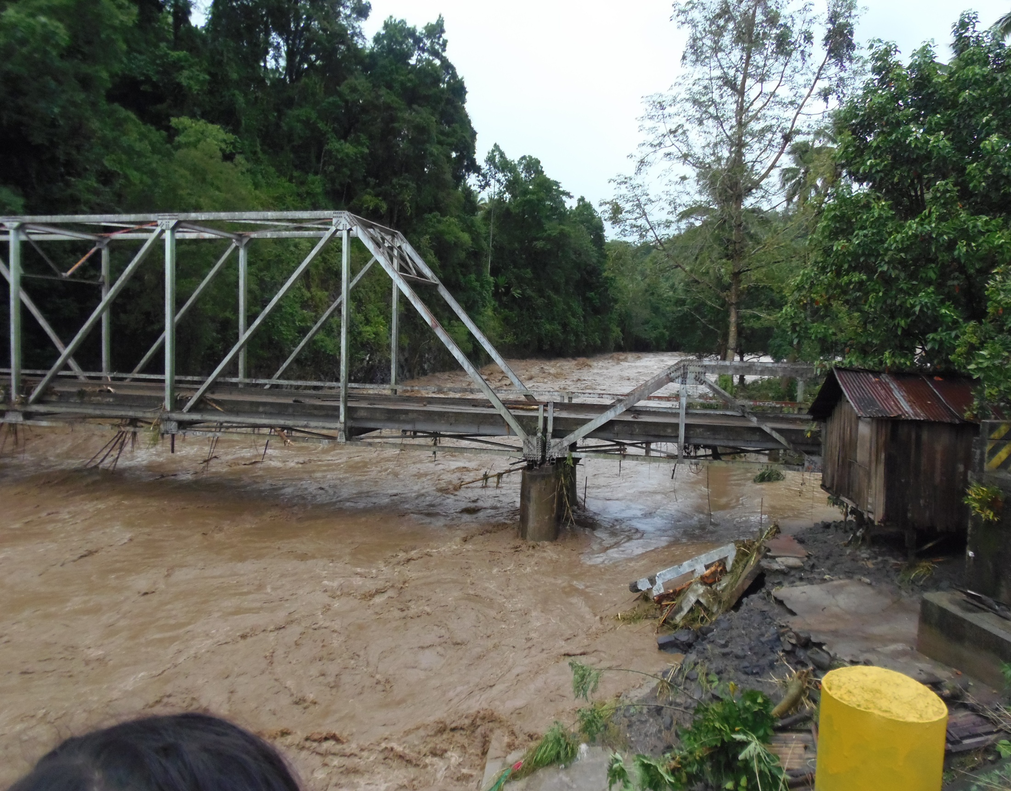
Lagmay et al., 2013
Ugiaban Bridge in Cagayan de Oro, Philippines
Washed out during typhoon Pablo

Slide 5
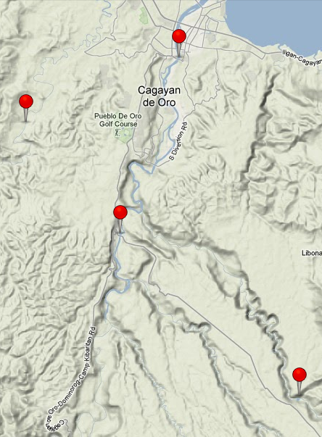
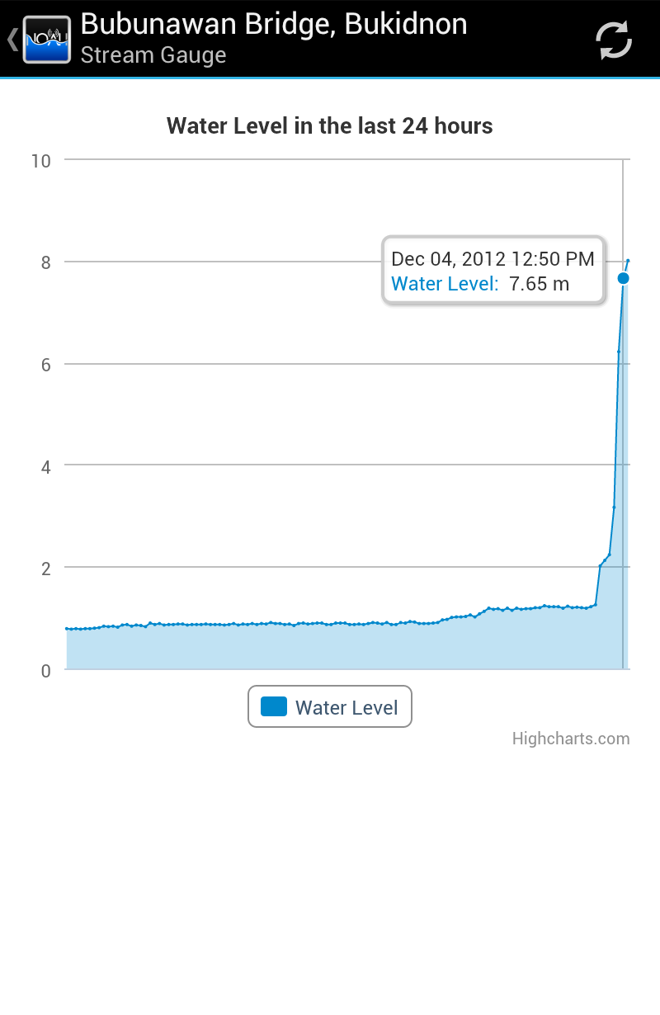
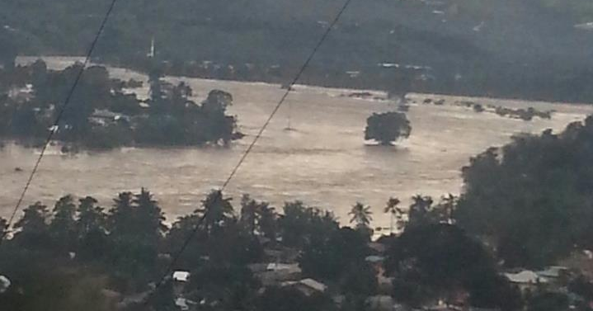
Lagmay et al., 2013

Slide 6
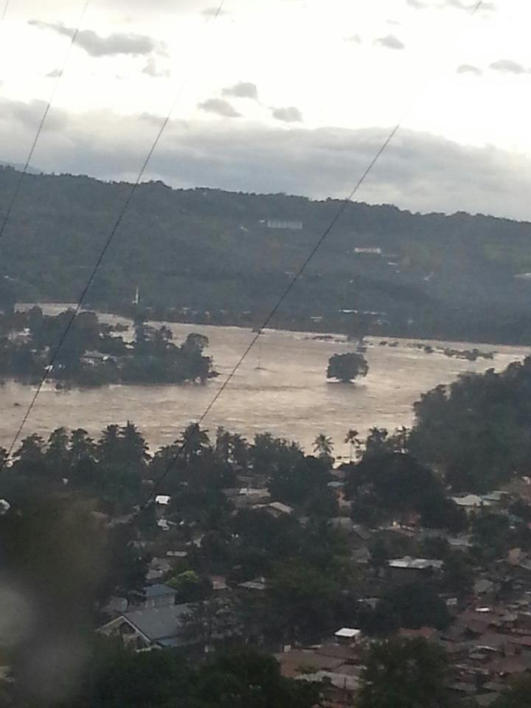
Lagmay et al., 2013
Flash flood at 4:00 pm
On 4 Dec. 2012

Slide 7
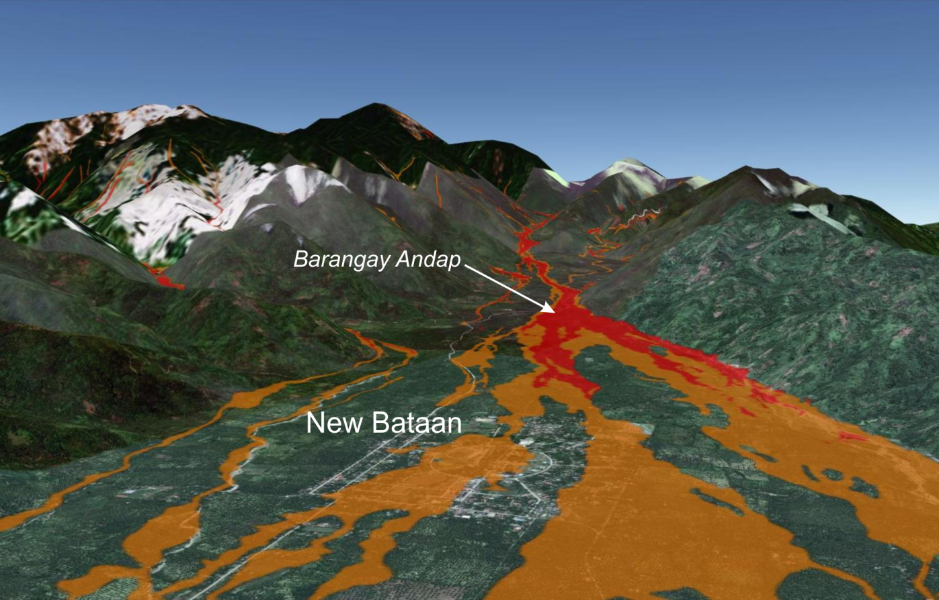
Lagmay et al., 2013
Debris flow in New Bataan

Slide 8
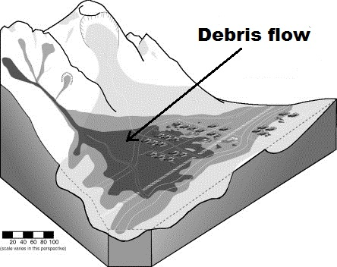
Lagmay et al., 2013
(Mathias Jacob, 2005)

Slide 9
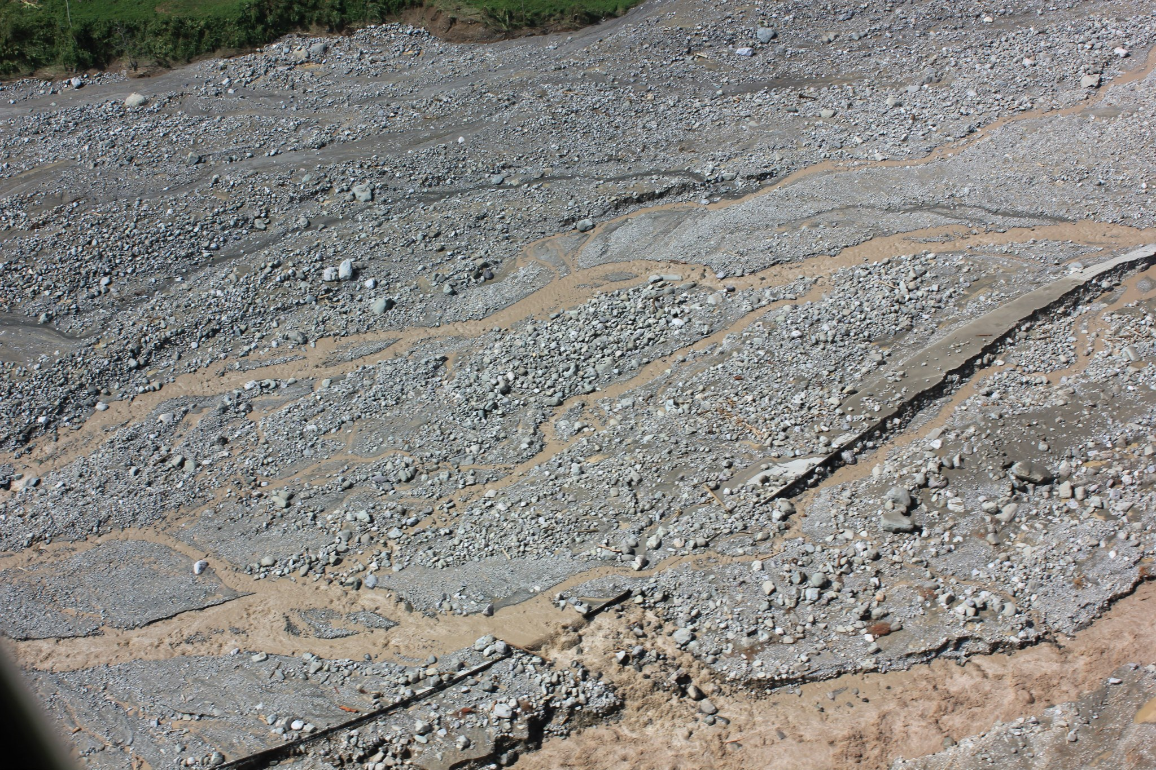
Lagmay et al., 2013
Aerial view of debris flow deposit at Barangay Andap, New Bataan, Compostela Valley

Slide 10
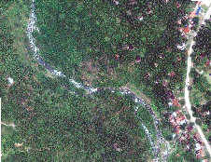
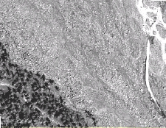
Lagmay et al., 2013
Bgy. Andap, before and after typhoon Pablo images

Slide 11
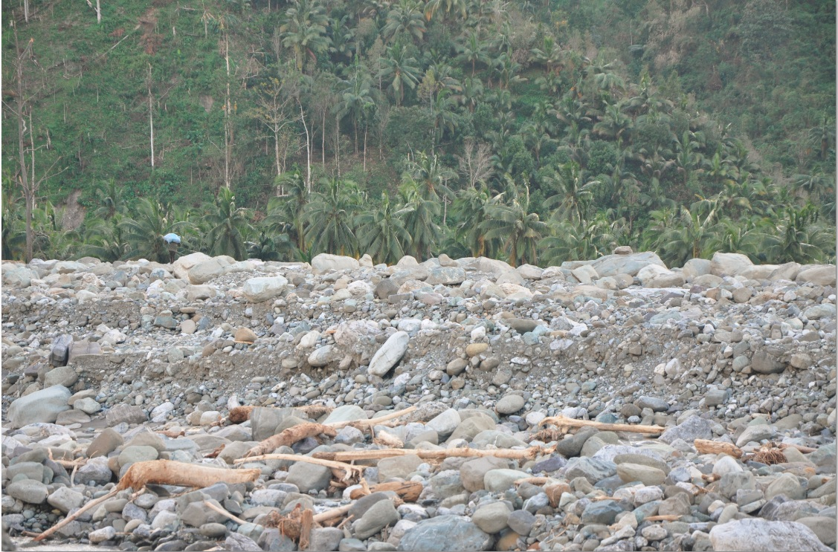
Lagmay et al., 2013
1.5 m
7.5-9 m
Debris flow field in New Bataan, Compostela Valley

Slide 12
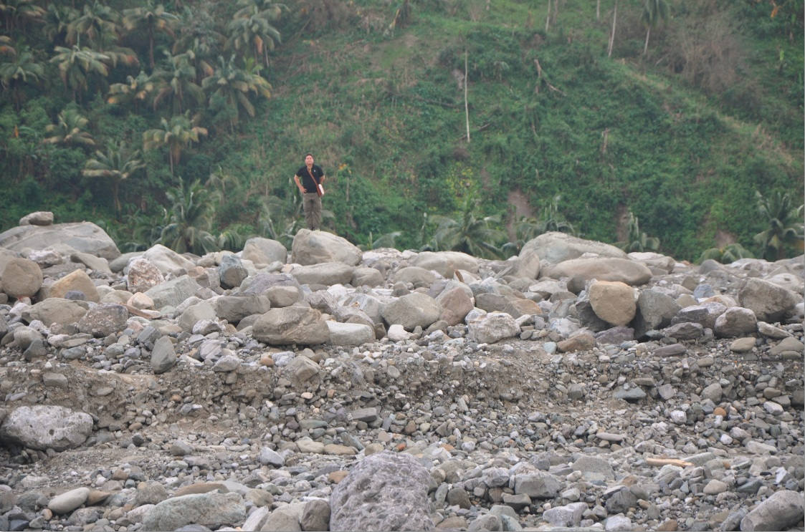
Lagmay et al., 2013
Debris flow field in New Bataan, Compostela Valley

Slide 13
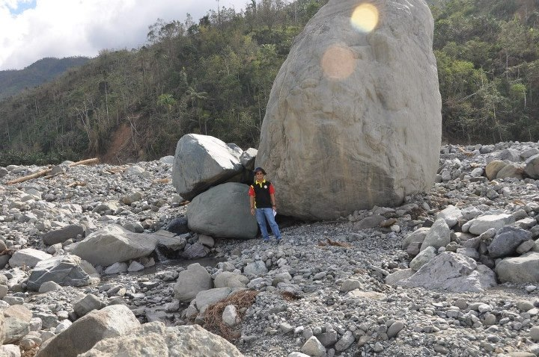
Lagmay et al., 2013
Debris flow field in New Bataan. Volume of deposit – 25-30 million cubic meters

Slide 14
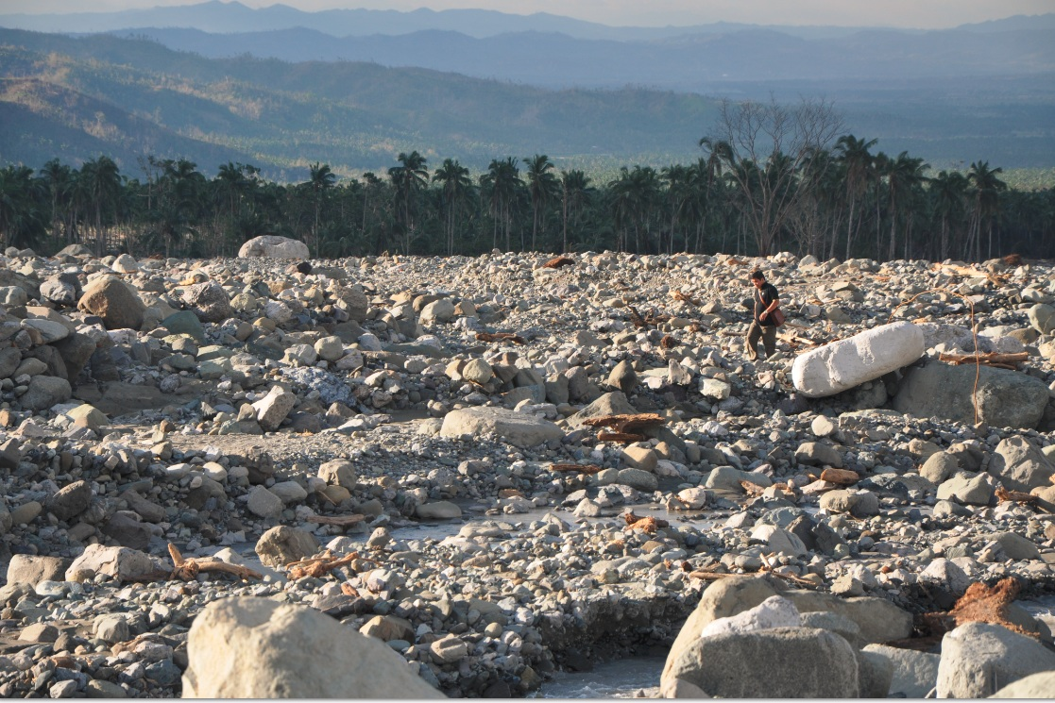
Debris flow field in New Bataan, Compostela Valley

Slide 15


Slide 16
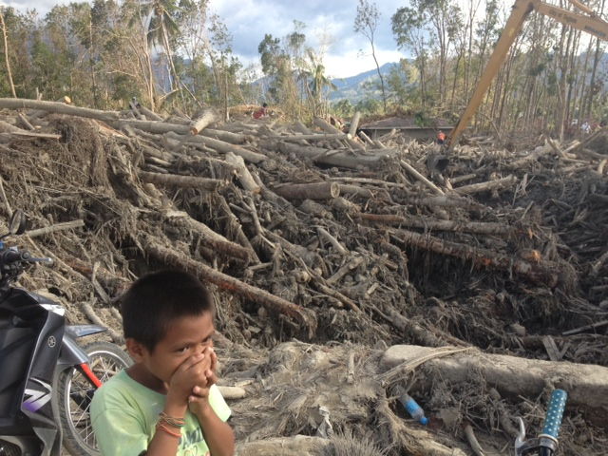
Lagmay et al., 2013
Debris flow field in New Bataan, Compostela Valley

Slide 17
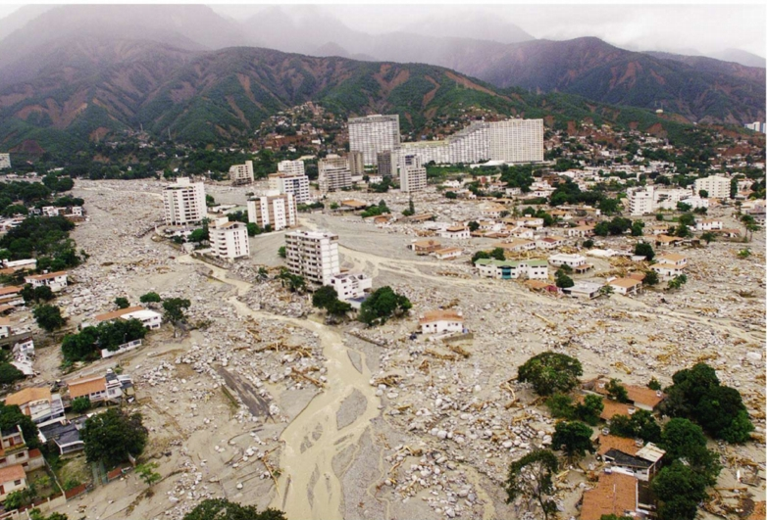
Debris flow field in Cordillera de La Costa, Vargas, Venqezuela. 19,000 died in 1999
http://www.webpages.uidaho.edu/~simkat/cors220_files/lecture12.html

Slide 18
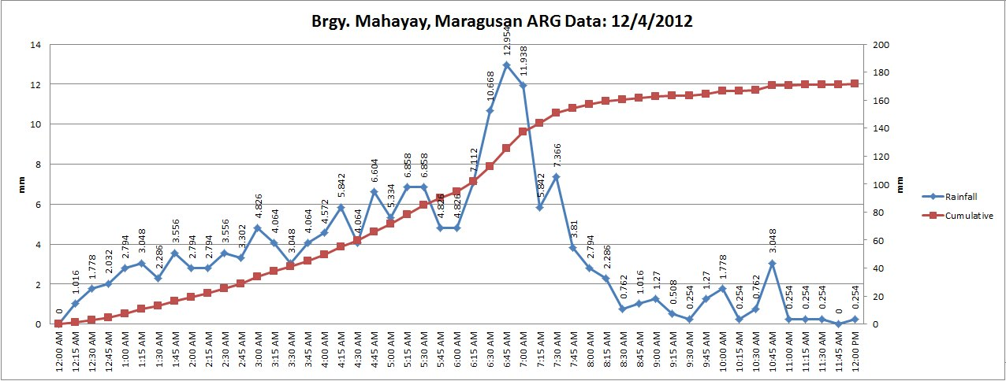
Lagmay et al., 2013

Slide 19
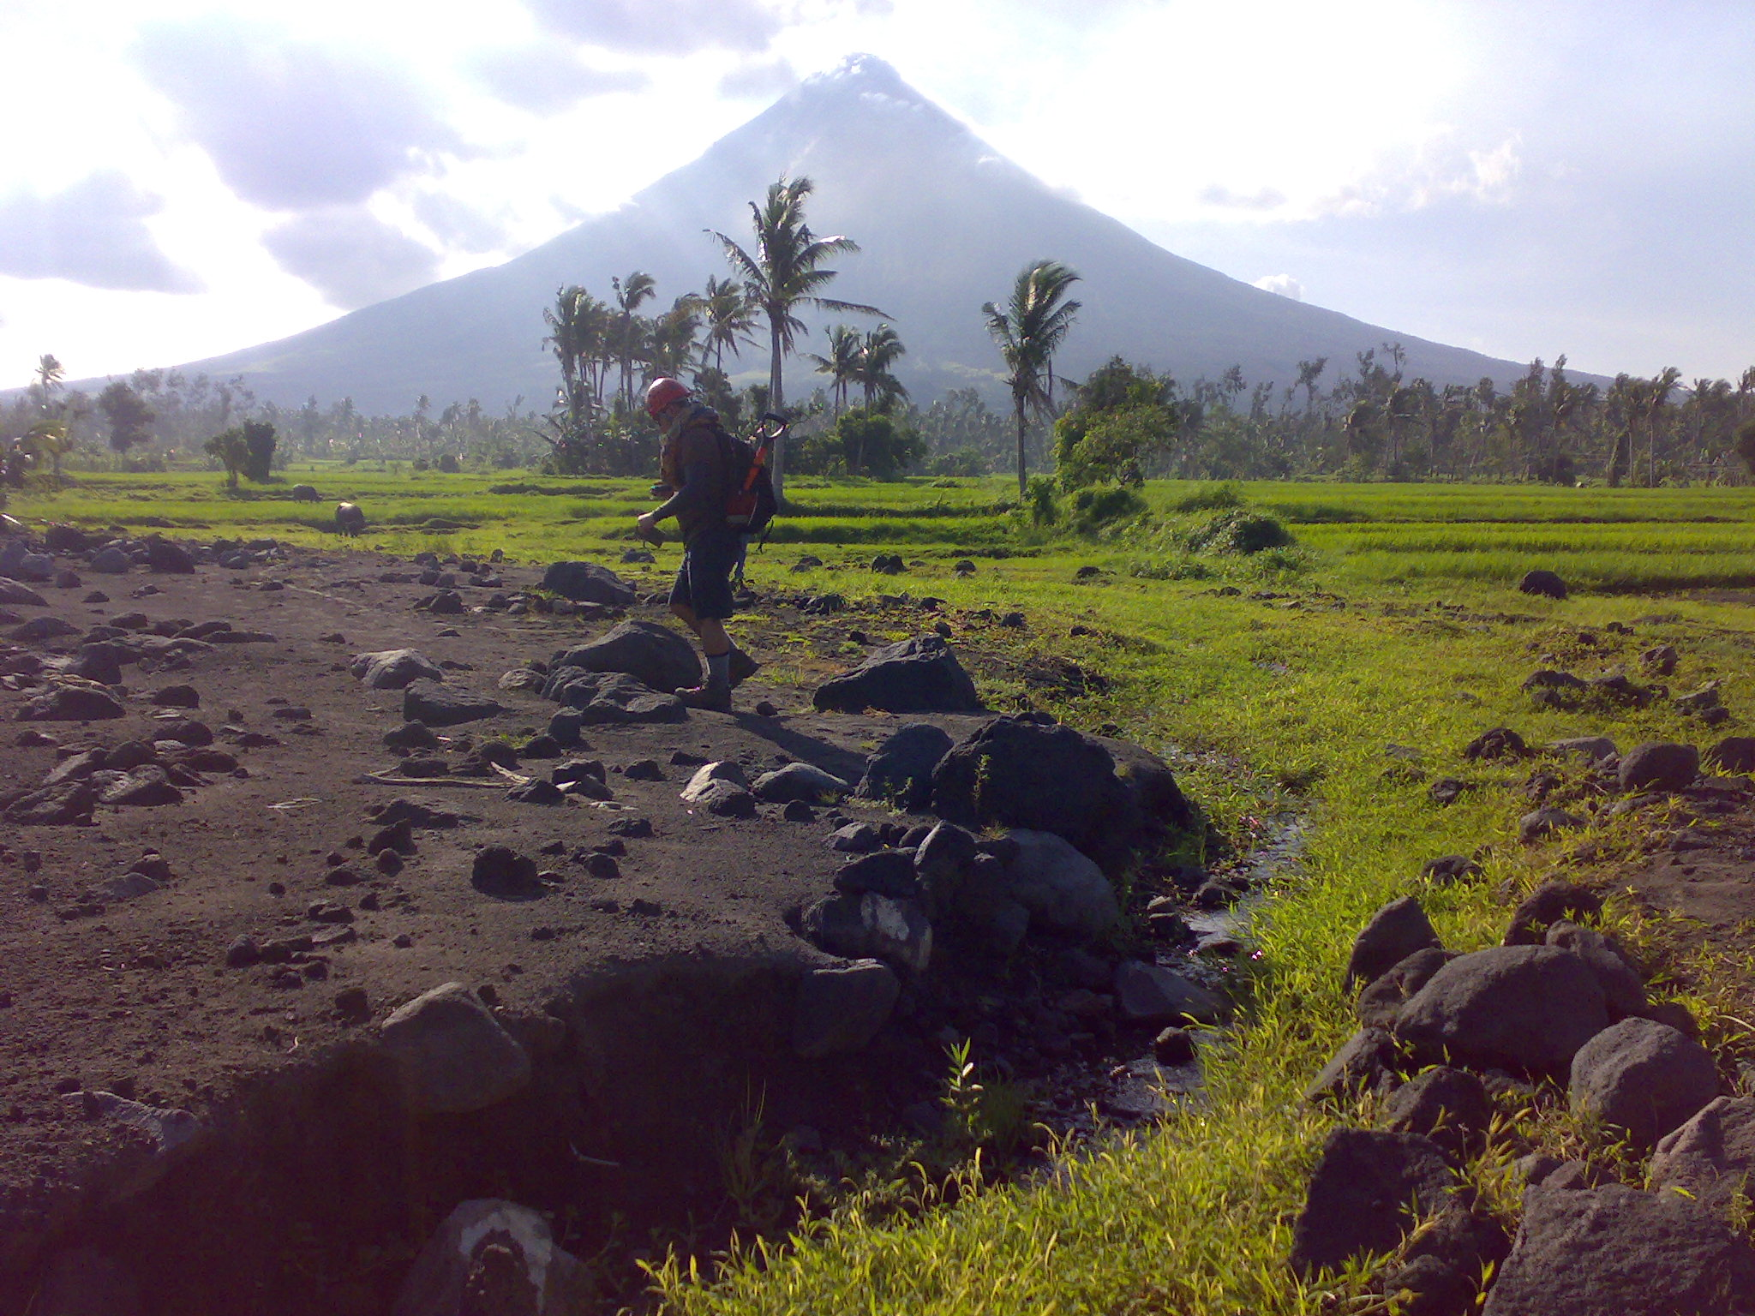
Mayon volcano lahars deposits . Lahars triggered by typhoon Durian in 2006

Slide 20
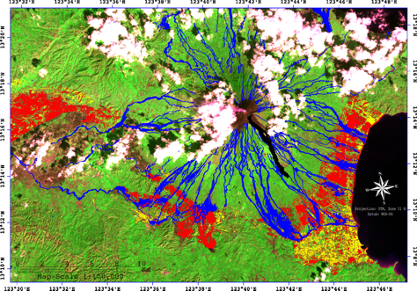
Basud
Padang
Guinobatan
Bongga
Camalig
Daraga
Notes:
20

Slide 21
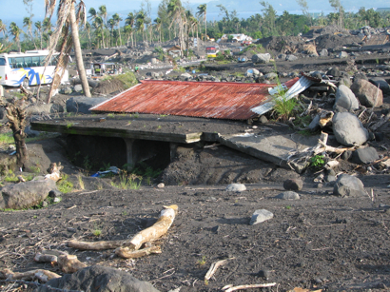
Nov. 30, 2006 Typhoon Durian 1399 dead US$ 66.4 million
18.7 million cubic meters
Notes:
21

Slide 22
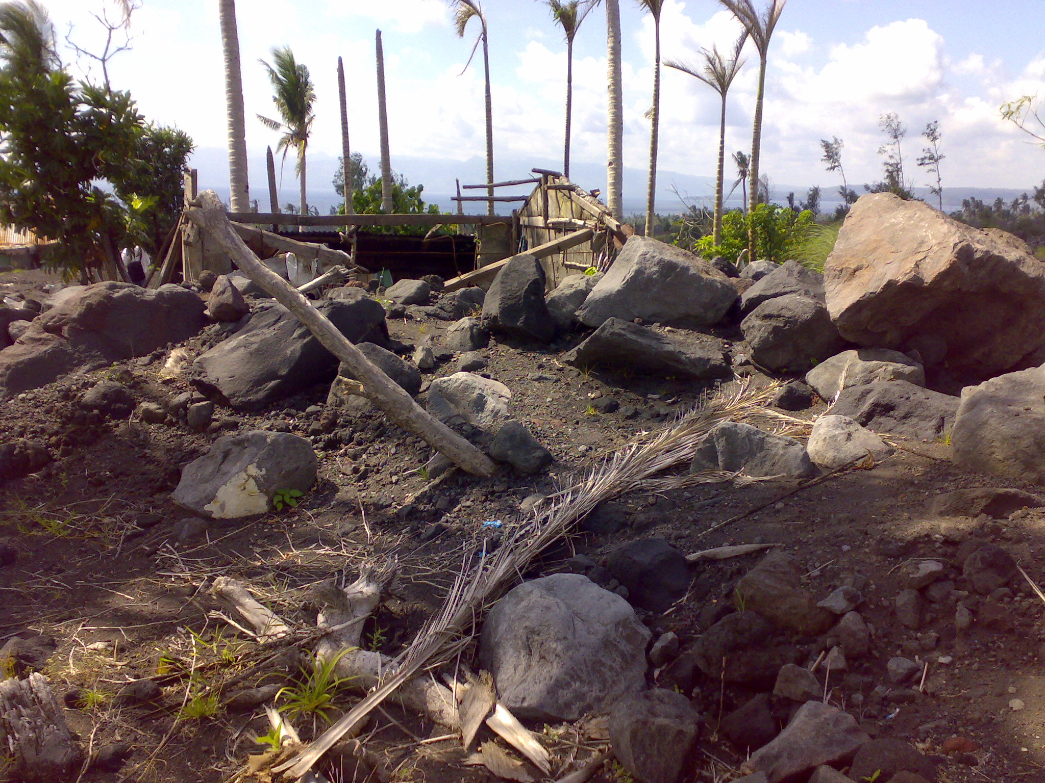

Slide 23
Padang/Daraga/
Guinobatan/
Basud Lahars

Slide 24
Debris flow (Lahar) triggering rainfall
Function of two factors:
  Intensity of rainfall (I in mm/hr)
  Duration (D in hrs)
Mayon field evidence (Rodolfo and Arguden,1991)
  59 lahar events
I = 27.3D^{-0.38}

Slide 25
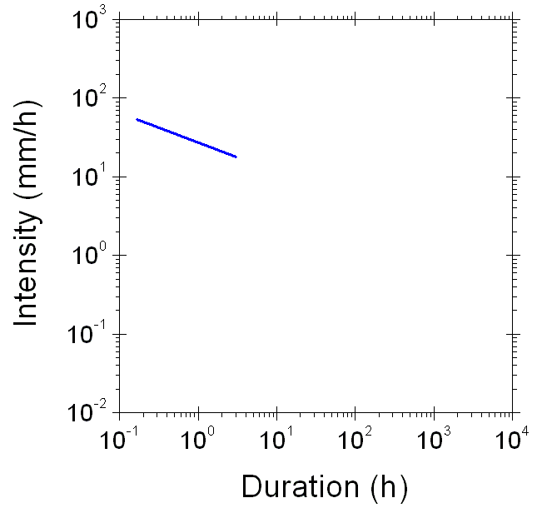
I = 27.3D^{-0.38}
Landslides (debris flow)
20 mm/hr
2 hours

Slide 26
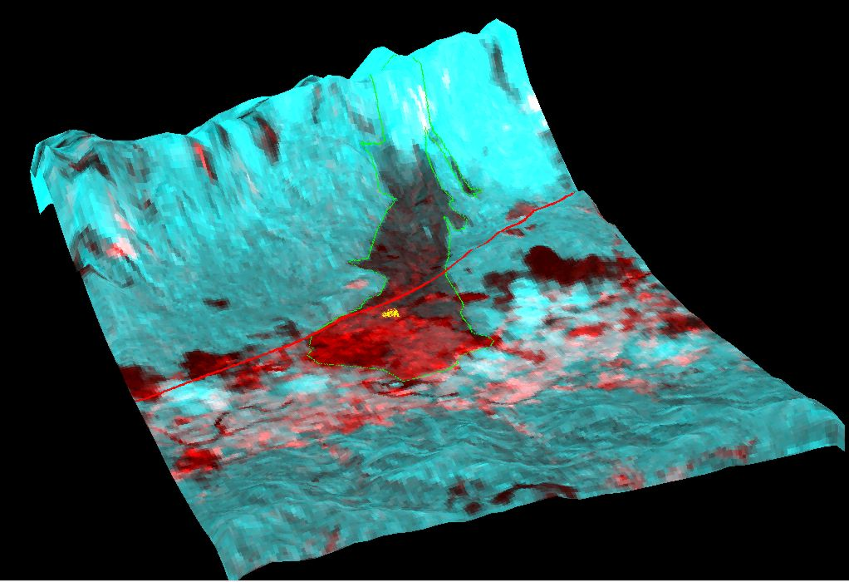
Guinsaugon
Population = 1,857
Notes:
26

Slide 27
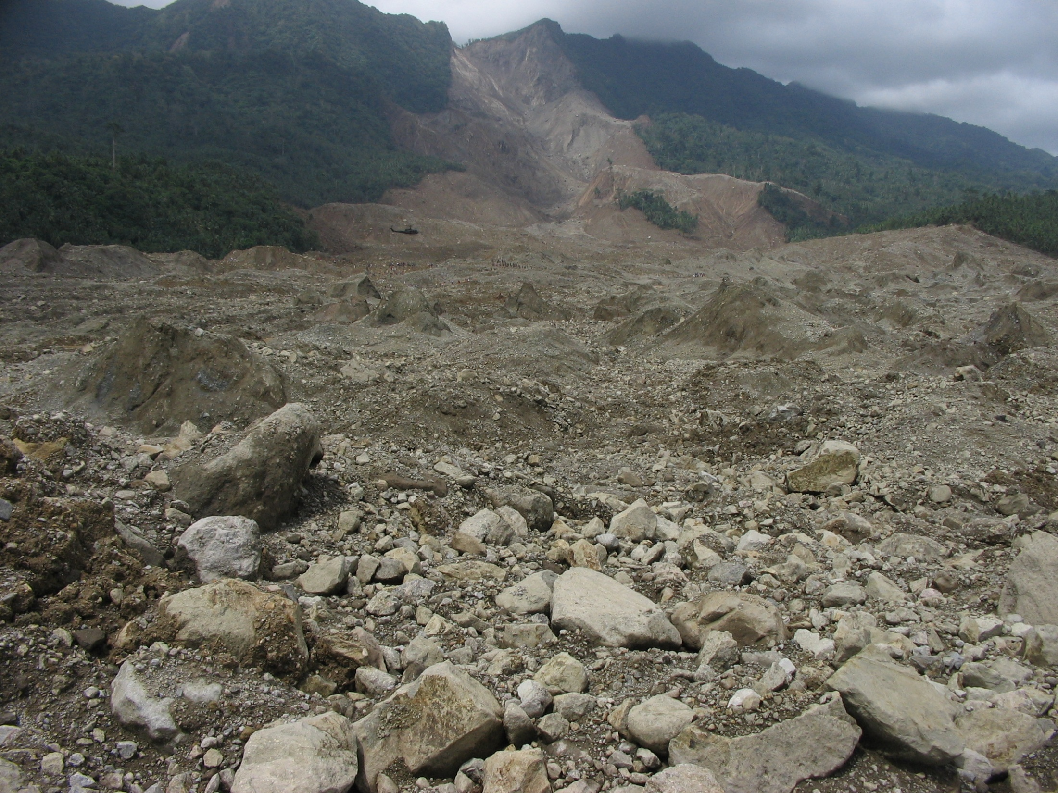
Feb. 17, 2006 Guinsaugon landslide 1126 dead US$ 2.203 million
15-20 million cubic meters
Notes:
27

Slide 28
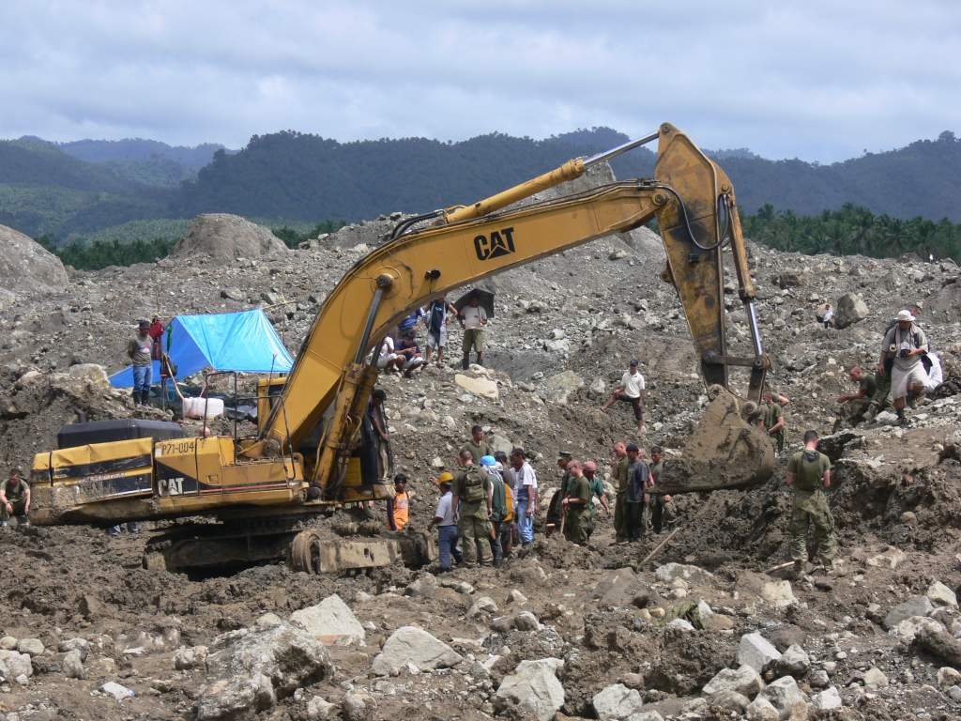
Day 6, Wed, 22 Feb 2006

Slide 29
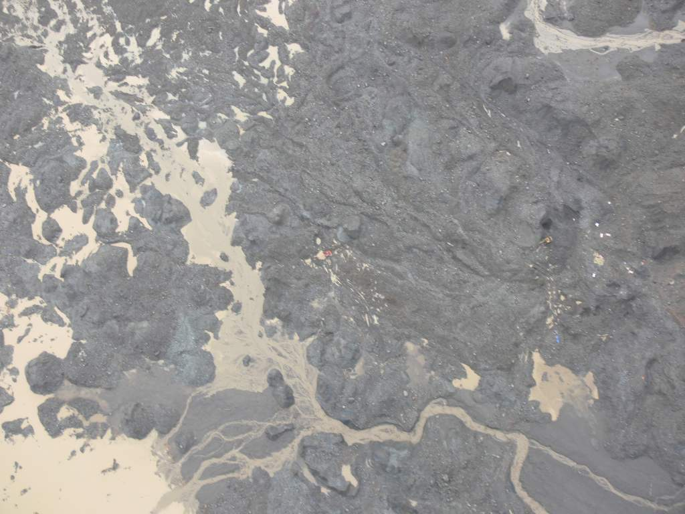
Day 7, Thurs, 23 Feb 2006

Slide 30

RESCUE 505
Day 7, Thurs, 23 Feb 2006

Slide 31
Landslide initiation threshold values

Slide 32
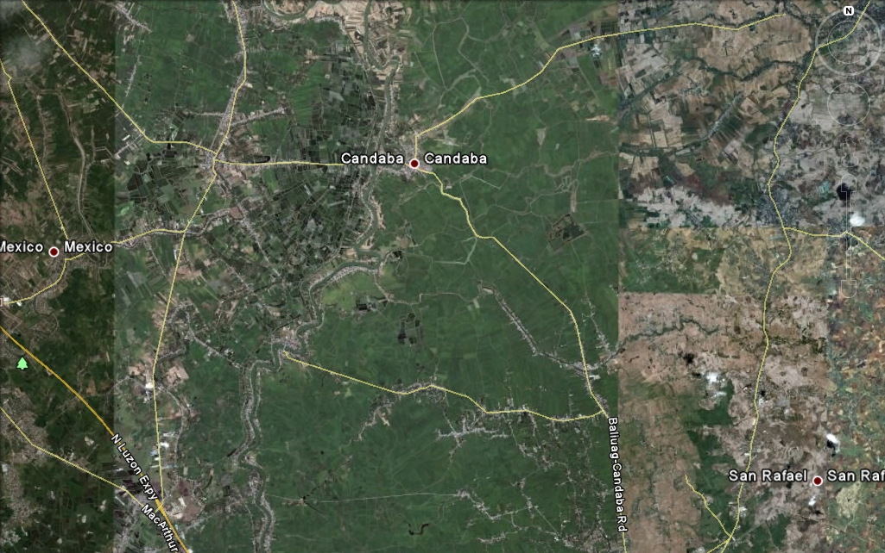
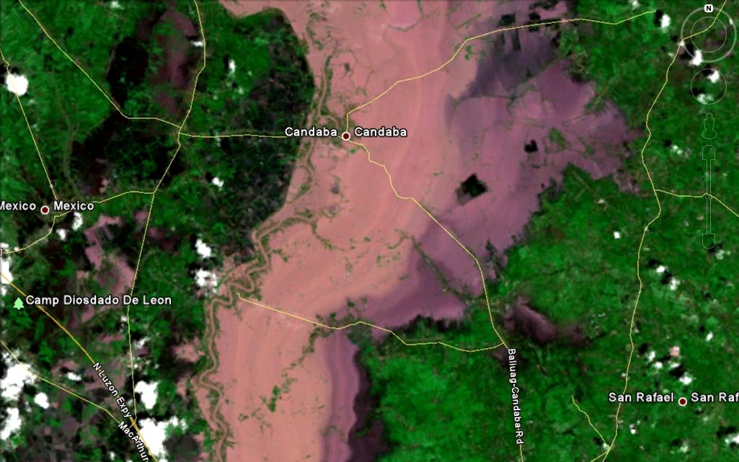



Pedring and Quiel typhoons in 2011
Notes:
Flooding in Candaba (October 5, 2011 image)

Slide 33

Tropical storm Sendong
UP NIGS team

Slide 34
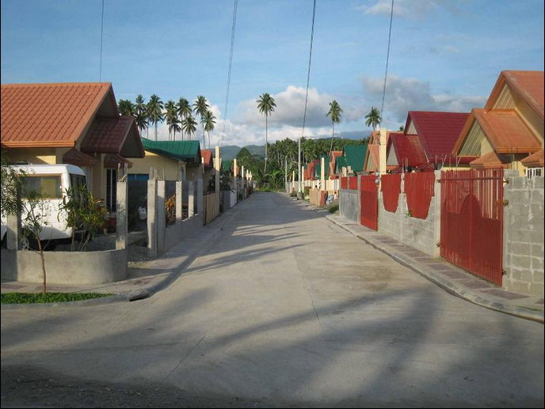
Orchids Home Subidivision, Santiago, Iligan
http://www.firmbuilders.com.ph/

Slide 35
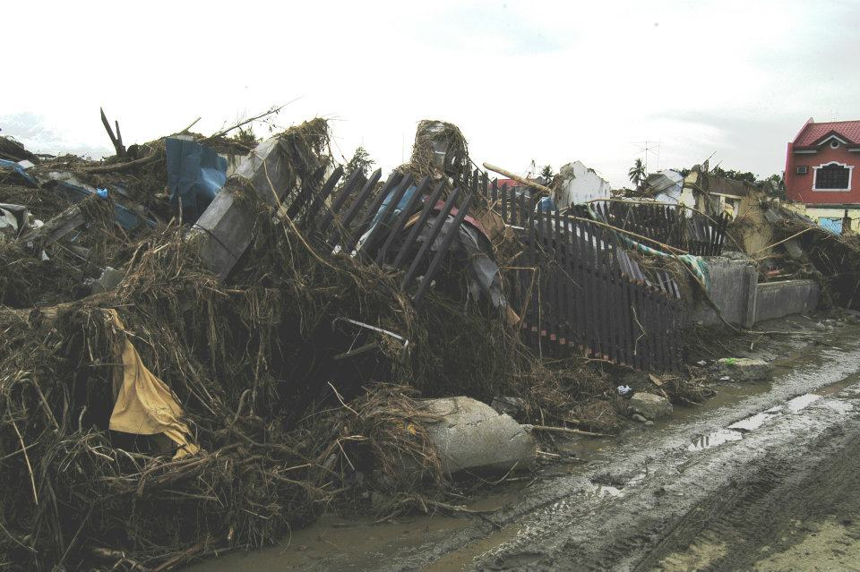
Orchids Home Subidivision, Santiago, Iligan

Slide 36
Typical rainfall amounts and intensities
Reming (2009) 47.5 mm/hour; 489.2 mm mostly delivered in 18 hours
Frank (2008) 354 mm on 20 June 2008
Ketsana (2009) 90 mm/hour; 455 mm mostly delivered in 6 hours
Pepeng (2009) 54 mm/hr; 190 mm from 8 am of October 3 to 8 am October 4, 2009

Slide 37
Typical rainfall amounts and intensities
Pedring and Quiel (2011) - 50 mm/hr; ≥ 375 mm combined for Pedring and Quiel
Sendong (2011) - ~40 mm/hr; 180 mm mostly delivered in 6-7 hours
Habagat (August 2012) - 58.93 mm/hr (QCPU station) ; total 1007 mm of rain in 3 days from Aug 6-7

Slide 38


DOST PROJECTS UNDER THE NOAH
In response to President Aquino’s instructions to put in place a responsive program for:
flood mitigation, specifically targeting a 6 hour flood early warning system for communities along 18 major river systems;
enhancement of geohazard maps and;
enhancement of storm surge vulnerability maps
the DOST is presenting the
Nationwide Operational Asessment of Hazards
DEPARTMENT OF SCIENCE AND TECHNOLOGY

Slide 39
DOST PROGRAMS UNDER THE NOAH PROGRAM
Project NOAH
HydroMet Sensors
Development
DREAM-LIDAR
FloodNET
Hazard Information
Media
Landslides
and Geohazards
Doppler System Development
Storm Surge
Coastal Erosion
and Storm Surge
Landslides
and Geohazards
Doppler System Development
HydroMet Sensors
Development
Hazard Information
Media
FloodNET
DREAM-LIDAR

Slide 40
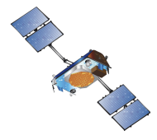
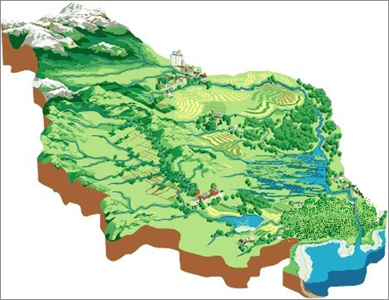
1
Satellite
(5 days before landfall)
2
RADAR
(24 hrs before landfall)
4
Water Level Sensors
(3-6 hours before flooding)
3
Auto. Rain Gauges
(6-9 hours before flooding)

Slide 41

30m Resolution
LIDAR DSM
UK Environmental Agency
Notes:
Formerly known as
National Centre for Environmental Data and Surveillance (NCEDS)
Or
Science Enterprise Centre
Or
Just “Twerton”

Slide 42
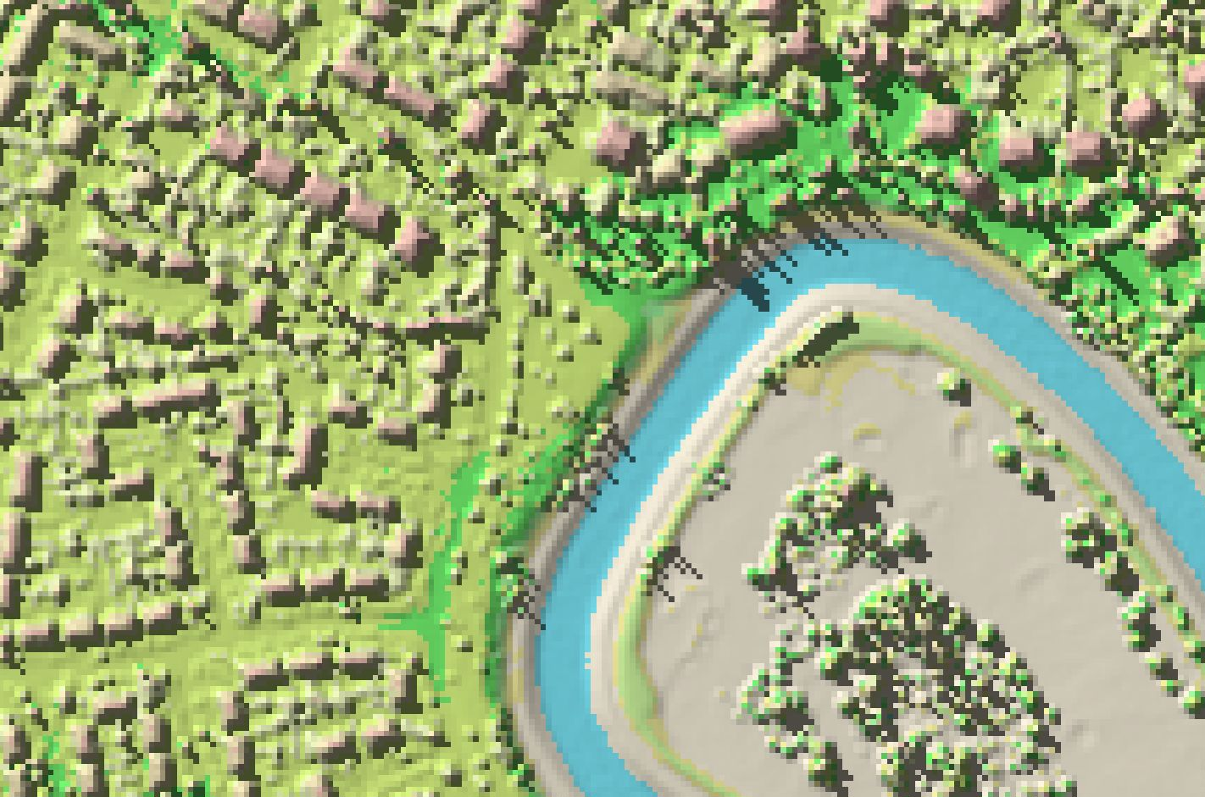
2m Resolution
LIDAR DSM
UK Environmental Agency
Notes:
Formerly known as
National Centre for Environmental Data and Surveillance (NCEDS)
Or
Science Enterprise Centre
Or
Just “Twerton”

Slide 43
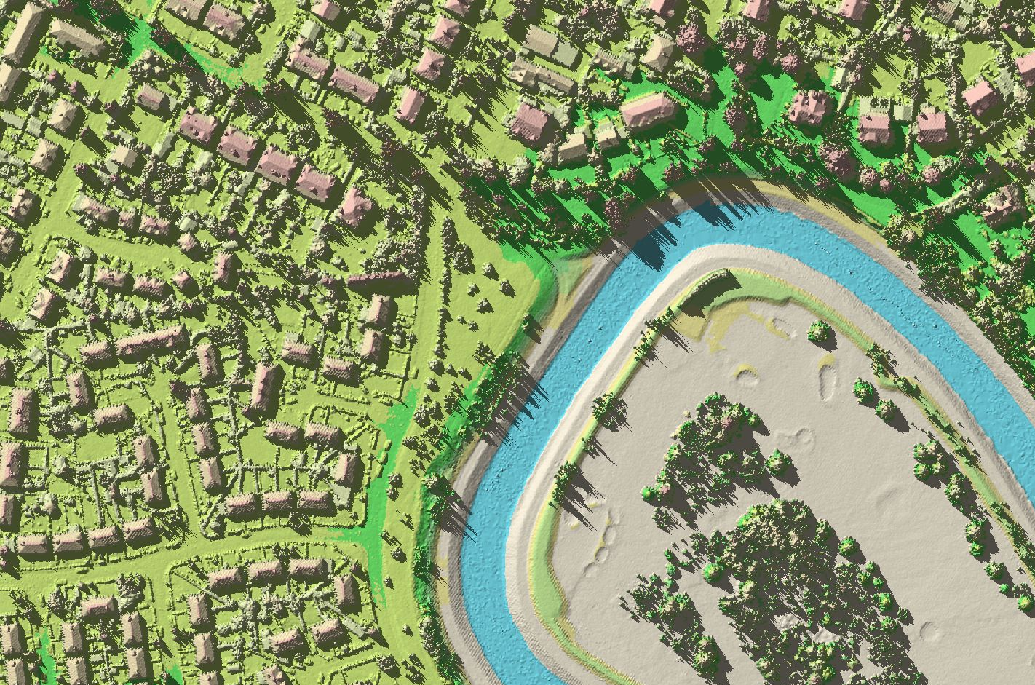
25cm Resolution
LIDAR DSM
UK Environmental Agency
Notes:
Formerly known as
National Centre for Environmental Data and Surveillance (NCEDS)
Or
Science Enterprise Centre
Or
Just “Twerton”

Slide 44
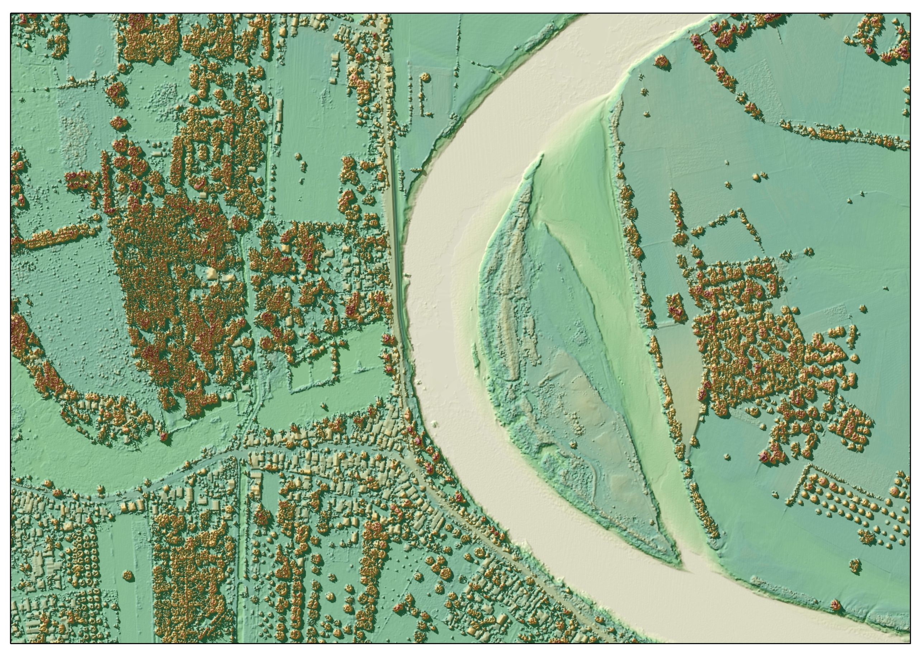

Slide 45
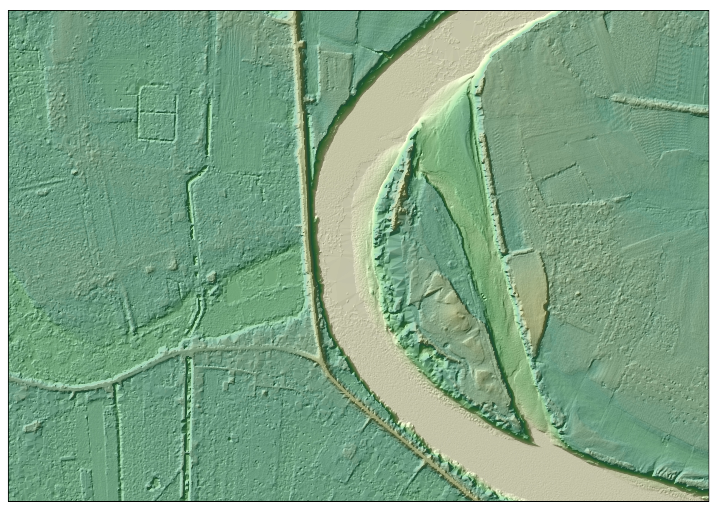

Slide 46
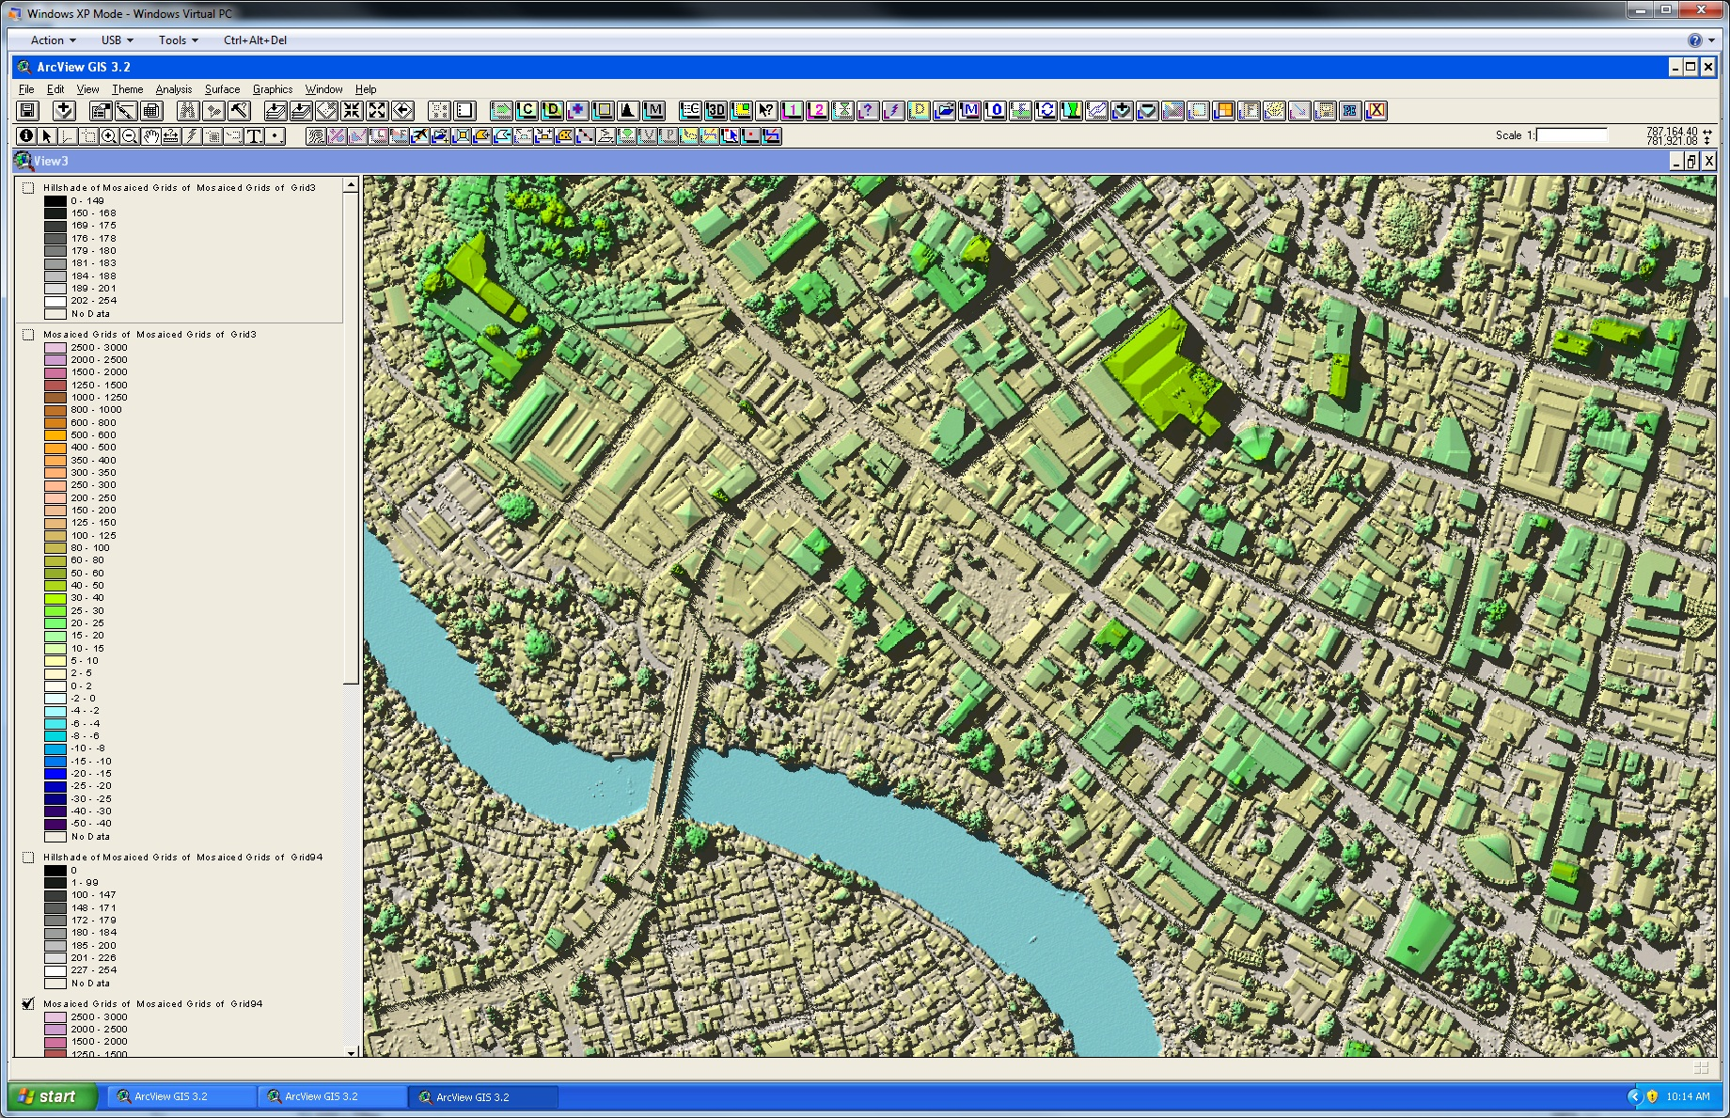

Slide 47
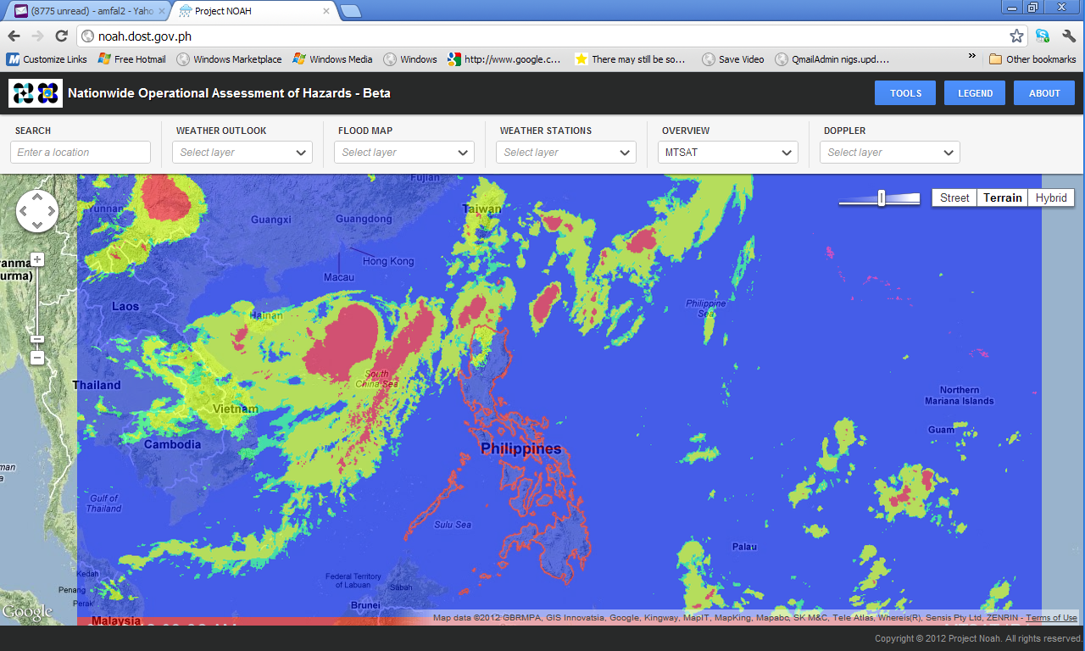
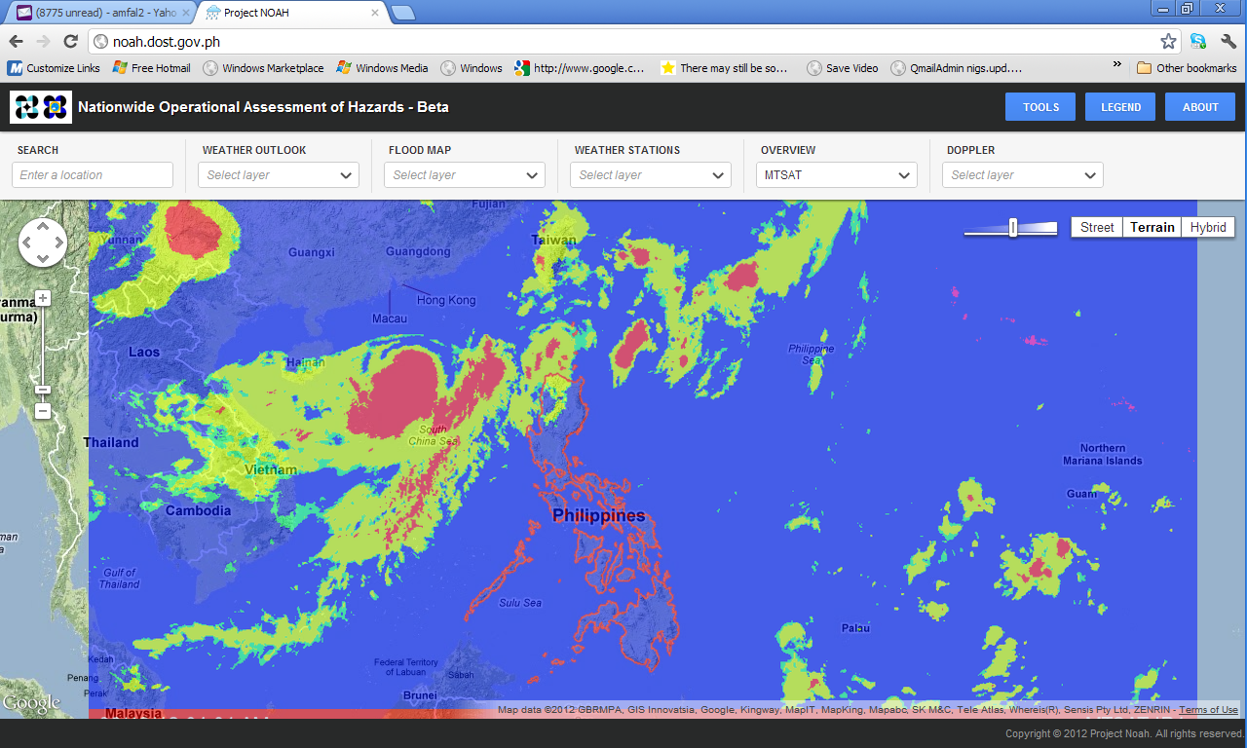
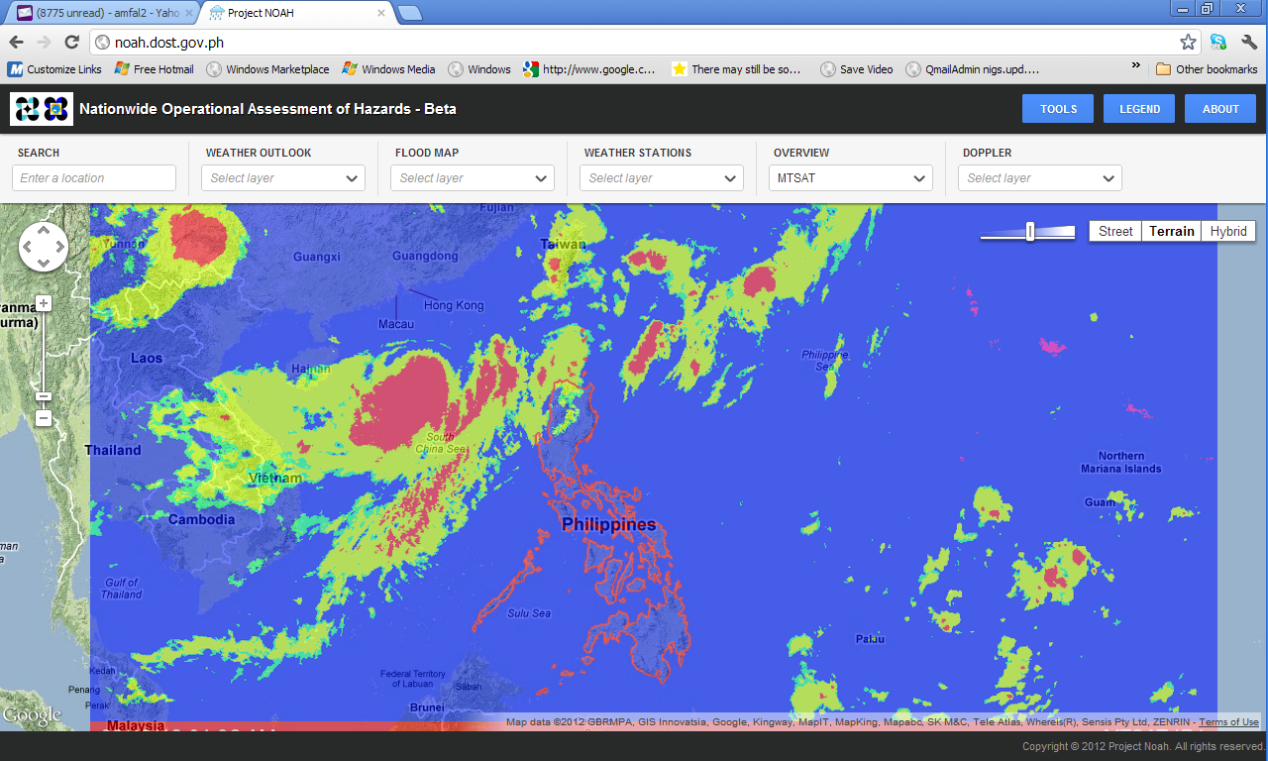

Slide 48
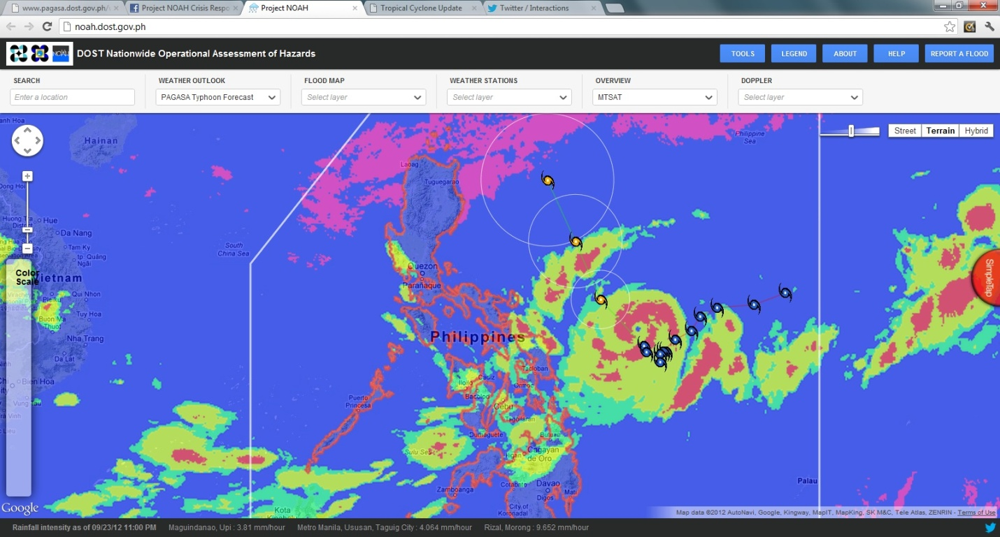

Slide 49
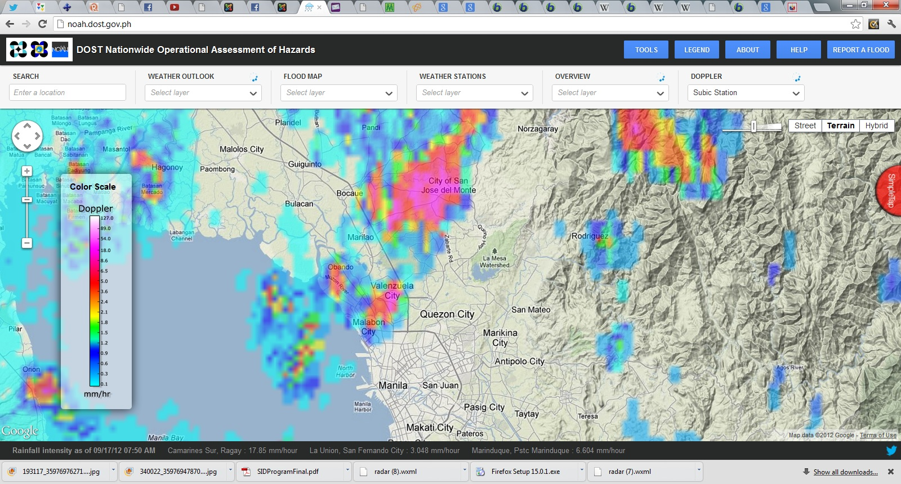

Slide 50
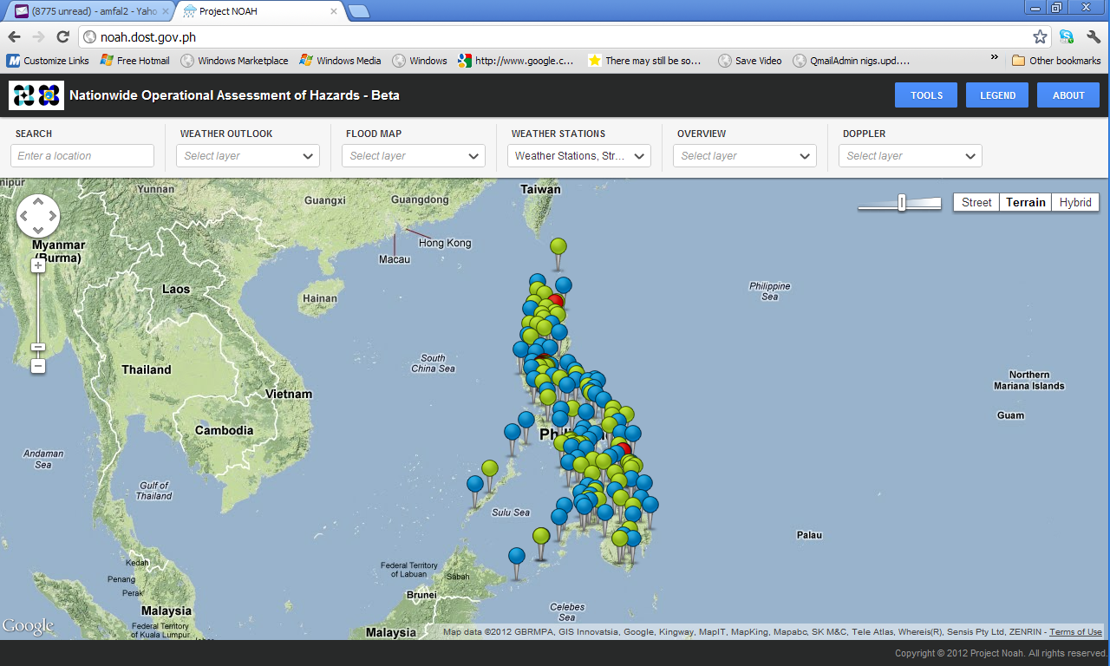

Slide 51
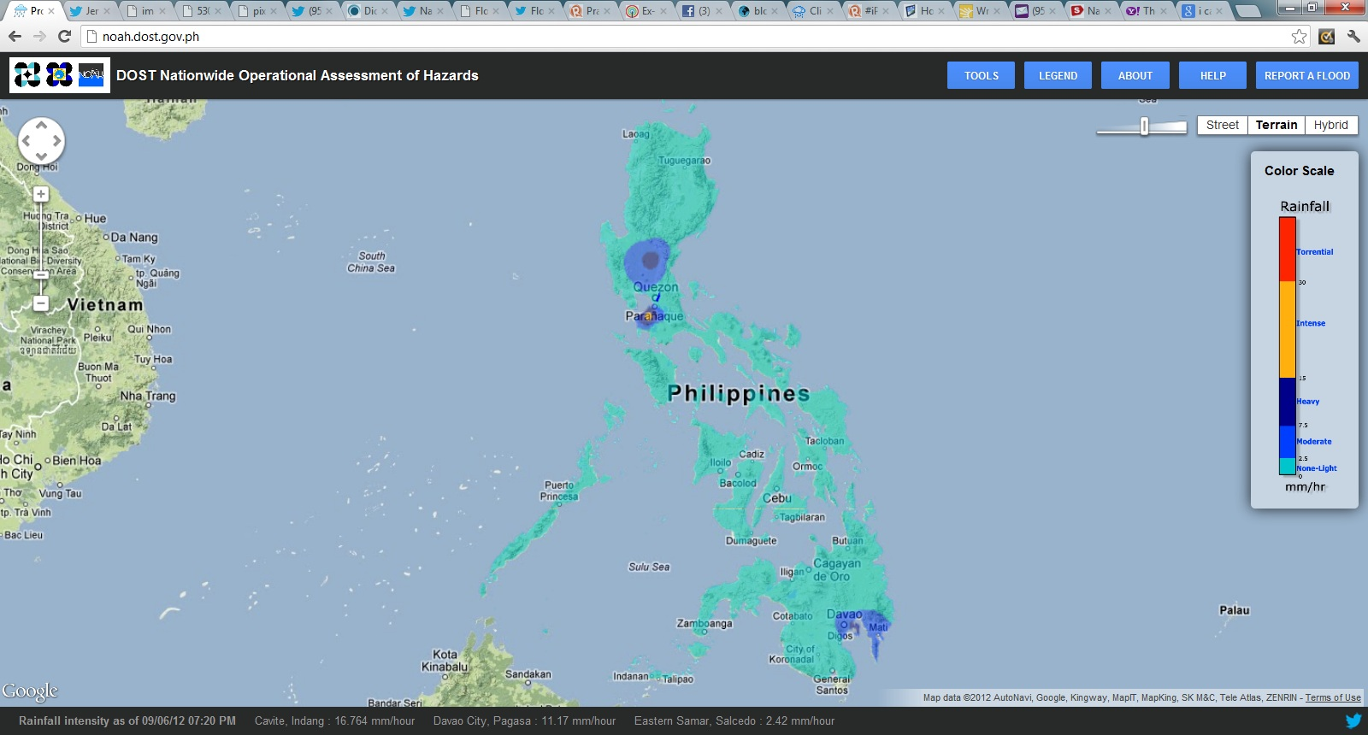

Slide 52
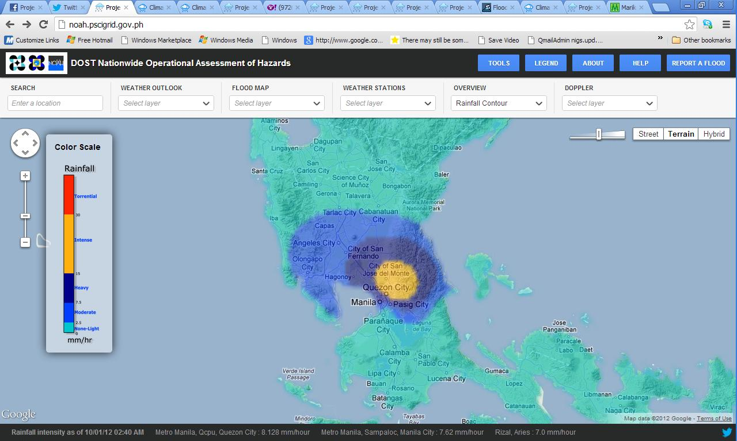

Slide 53
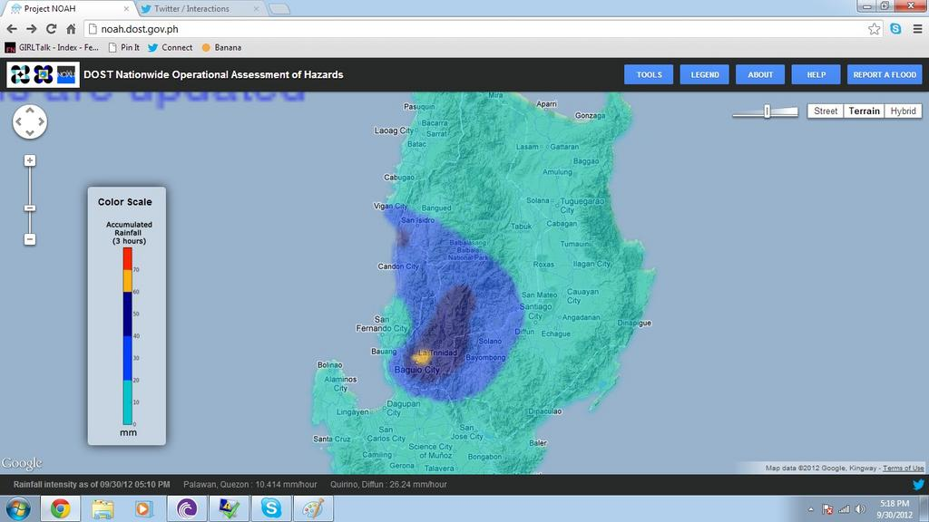

Slide 54
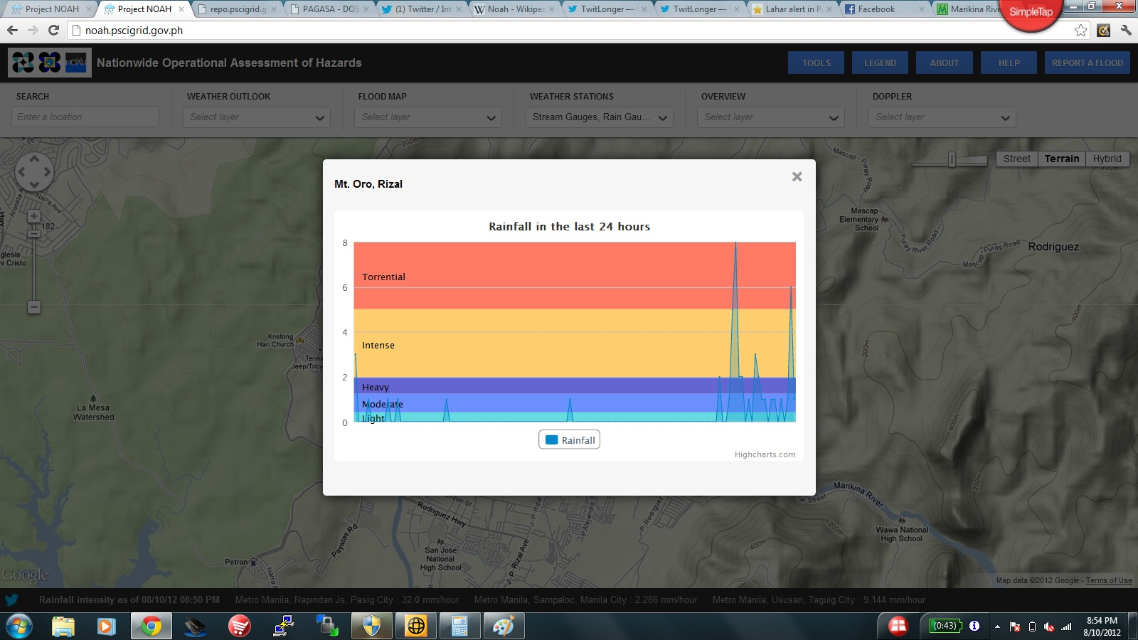

Slide 55
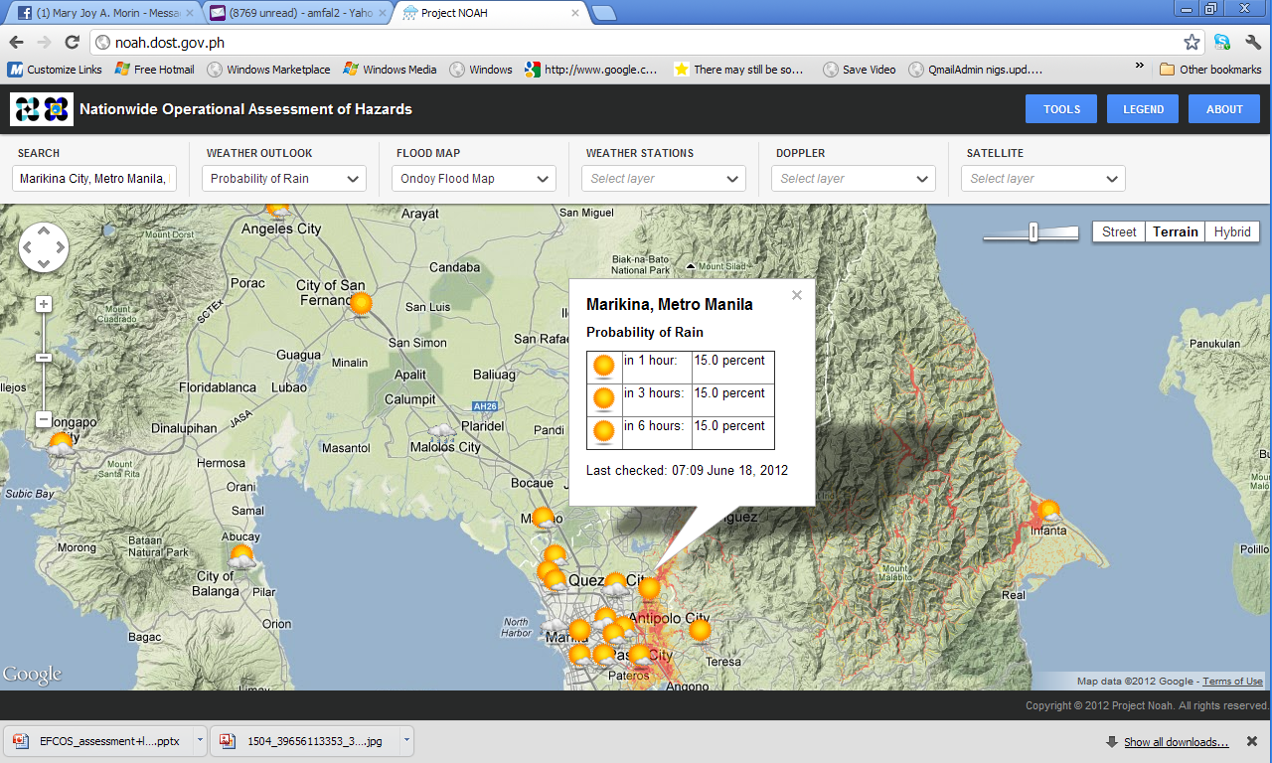

Slide 56


Slide 57


Slide 58


Slide 59


Slide 60



Rapid Flood Simulation for Flood Events
Notes:
With the availability of high-resolution data such as lidar, and bathymetric data, the prediction of water level rise can be translated to flood inundation as shown here for the habagat and july 3 events.

Slide 61
Marikina Watershed Modeling
Notes:
One of our more recent “victories” is our prediction of the rise in water level in Montalban on the night of Aug8. With the available data we were able to predict the rise hours before the event, and aided in warning the populace.

Slide 62







Slide 63


Slide 64


Slide 65



Slide 66



1.5 km model OLR versus MTSAT-2 IR imagery
13/10/10 00z through to 19/10/10 00z every 3 hours
Satellite
Notes:
With cooperation amongst ASEAN countries and cutting edge science we can plan ahead.

Slide 67



Slide 68

PHILIPPINE UNIVERSITIES’ SCIENCE OBSERVER

Slide 69
Thank you

